Slide 1
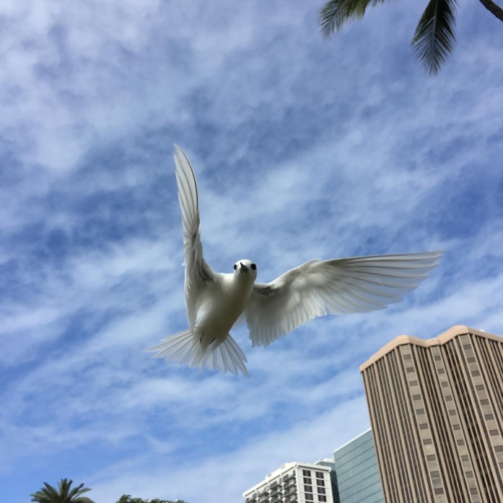
Hui Manu-o-Kū December 2022 Meetup
“To enhance awareness, appreciation, understanding and conservation of manu-o-Kū.”

Slide 2
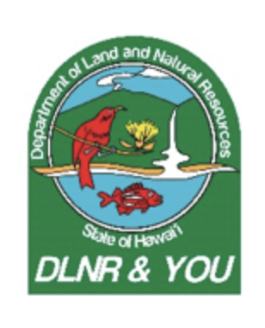
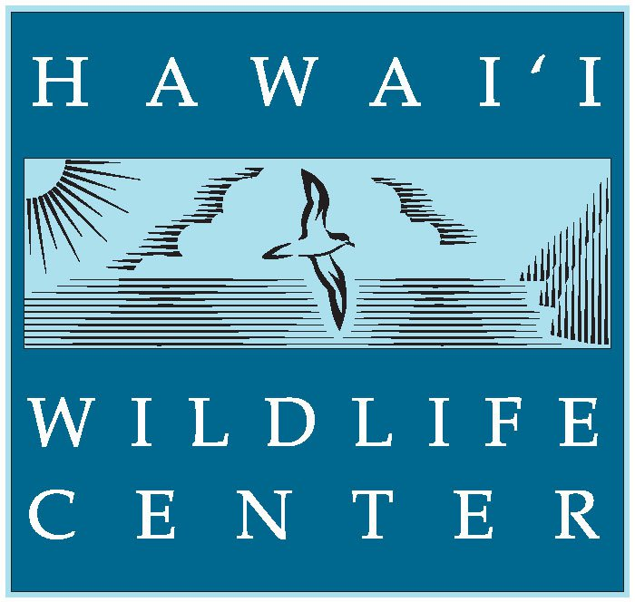
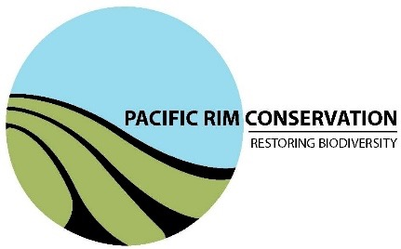
Thanks to our Partners!
Notes:
“our resident genius when it comes to all things seabirds”
Keith – He is the reason it was designated the official bird of honolulu. He has worked on countless projects for seabird conservation
Christine has helped with conservation planning, was instrumental in setting up the first manu-o-Kū festival in May, and has created the Oahu Seabird Group
Eric was responsible for the 2003 study of this population. He is also in charge of the current monitoring efforts to estimate the population number and to map nests for tree trimmers to avoid conflicts with white terns

Slide 3
What is the "Hui Manu-o-Kū”?
The Hui Manu-o-Kū is a group of conservationists and citizens that all have one thing in common: an interest and admiration for White Terns, or manu-o-Kū.
This group has formed to ensure that the official bird of Honolulu is taken care of and watched after.
We developed a citizen science initiative to help track the growing population in the city. Together, the Hui Manu-o-Kū and citizen scientists are working to ensure that the population is protected and cared for, so that they continue to thrive in Honolulu.
Coordinating our efforts for the benefit of the terns:
Protect active nesting sites
From predators, disruptive tree trimming
Return fallen chicks to their nesting spots
Identify threats to their urban habitat and breeding success
Increasing public awareness of the birds
“Itʻs all about the terns!”
Our Mission: To enhance awareness, appreciation, understanding and conservation of Manu-o-Kū.
Notes:
“tern enthusiasts”

Slide 4
Meeyaʻs preseention on YouTube

Slide 5
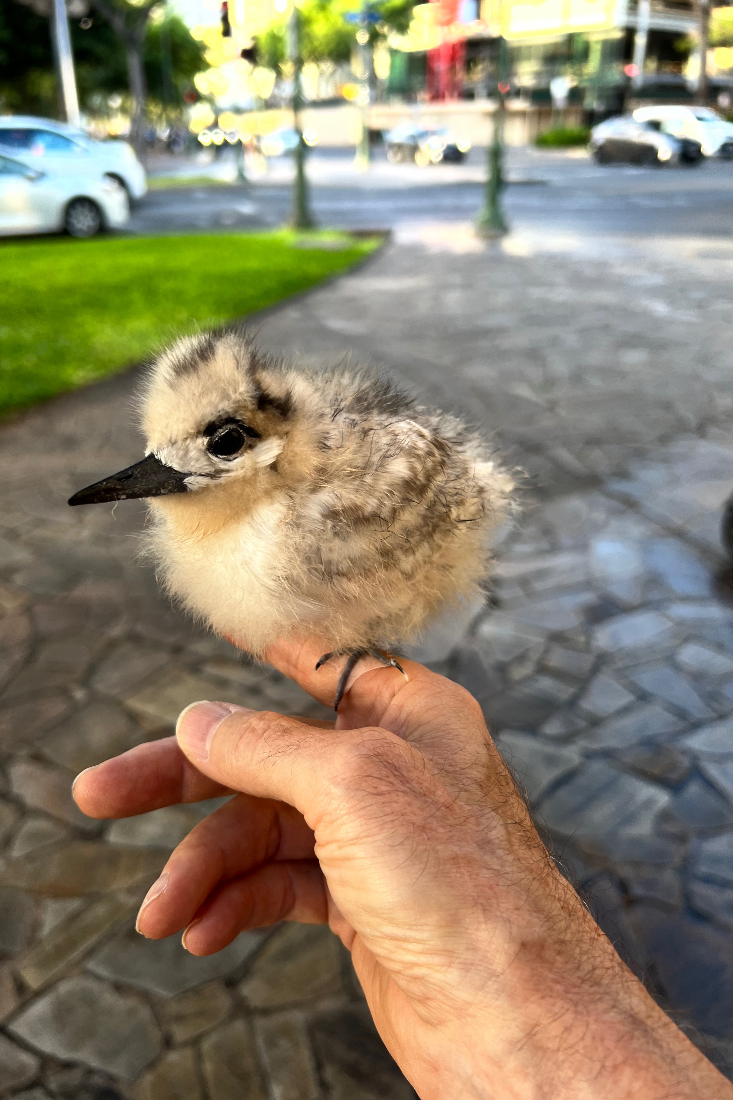
MOK Hotline and Rescues
63 calls to the Hotline in 2022 for fallen chicks and injured adults
16 Successfully reunited with parents
24 Rehabbed and returned to the wild
9 Died
2 Euthanized
11 currently in rehab
Over a dozen volunteers on our active call list
Scheduling more training after New Year

Slide 6
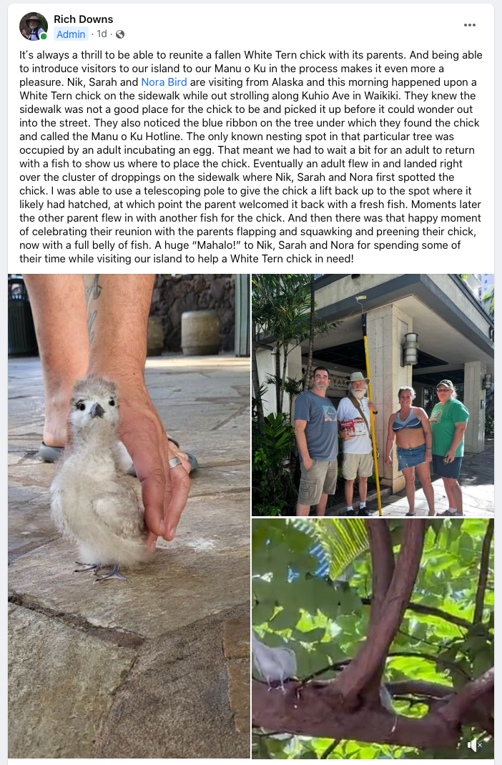
Dec 1 Waikiki Rescue

Slide 7
Updates: Increasing Understanding of the MOK through Citizen Science
Volunteers surveyed 1,512 known breeding trees so far in 2022
Data Collection to date for 2022
Breeding activity (egg or chick) documented in 785 trees
Up from 429 in 2021
5,024 observations submitted by volunteers
40 volunteers have submitted at least 1 observation this year

Slide 8
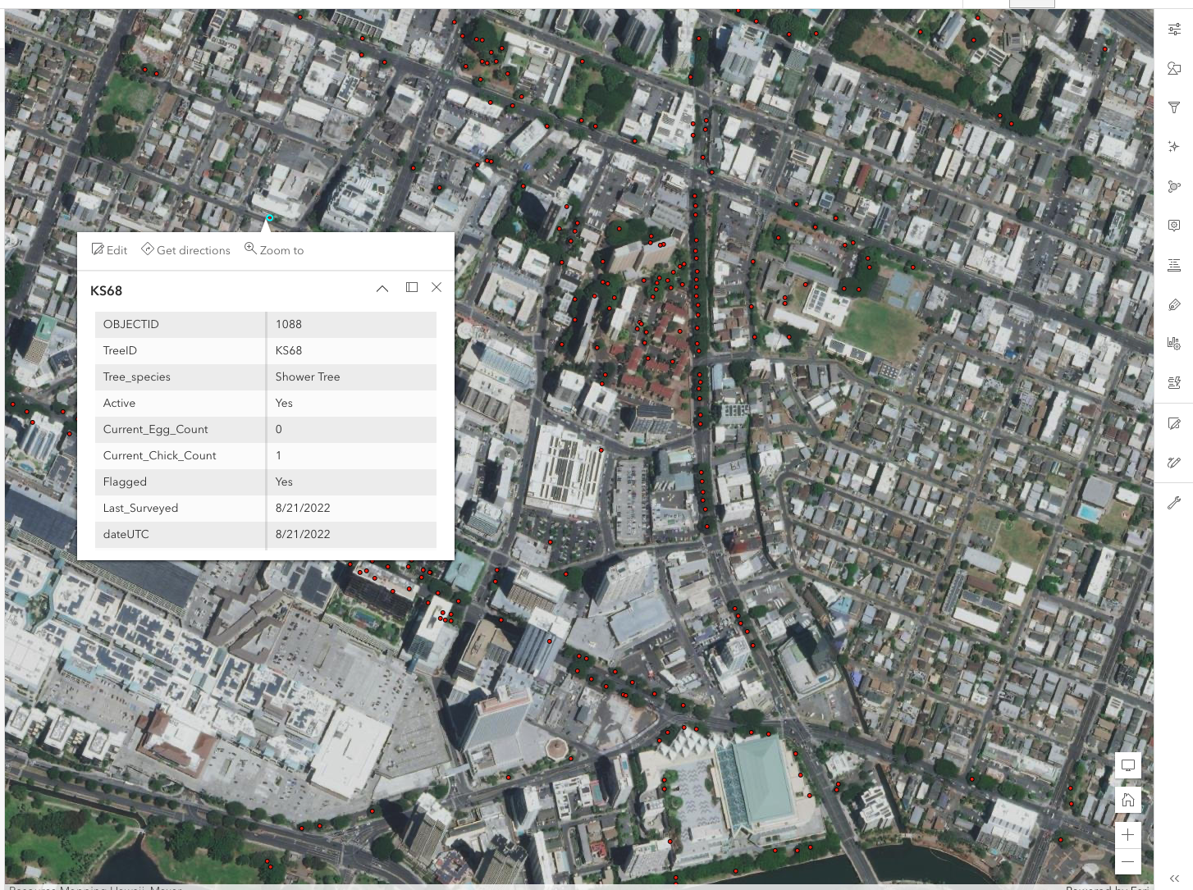
Integrating with ArcGIS Tools
Goal to improve user experience for volunteers collecting data and to improve our ability to analyze and use the data we collect.

Slide 9
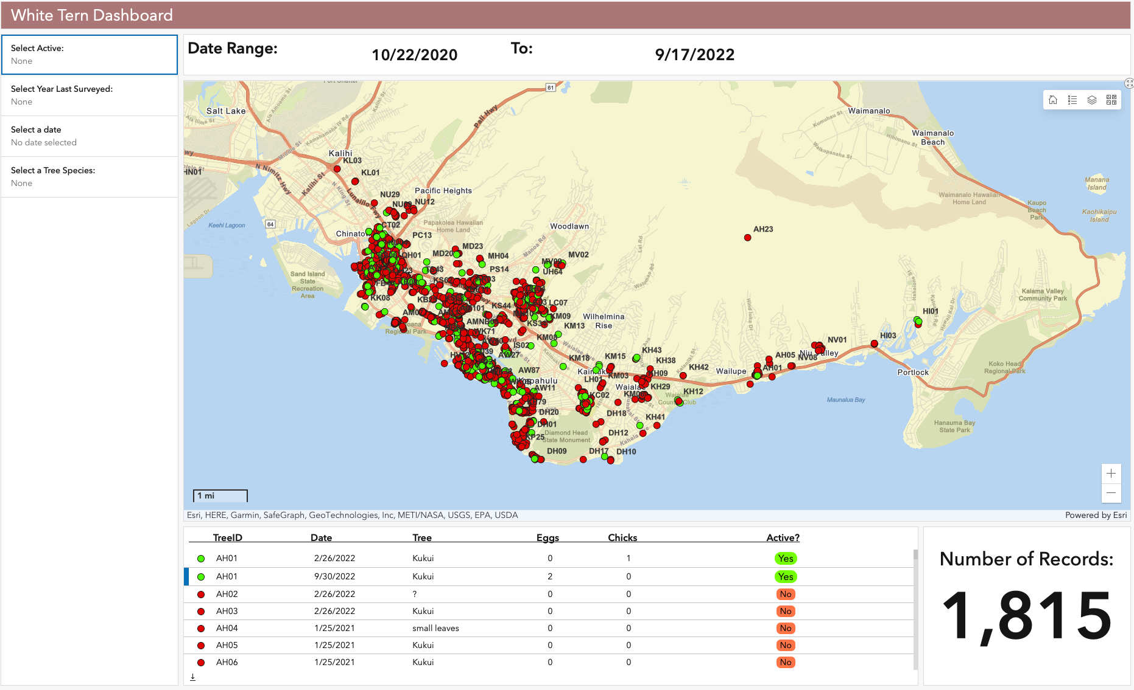
Integrating with ArcGIS Tools
Greater capability to interact with the data collected on White Tern breeding activity.

Slide 10
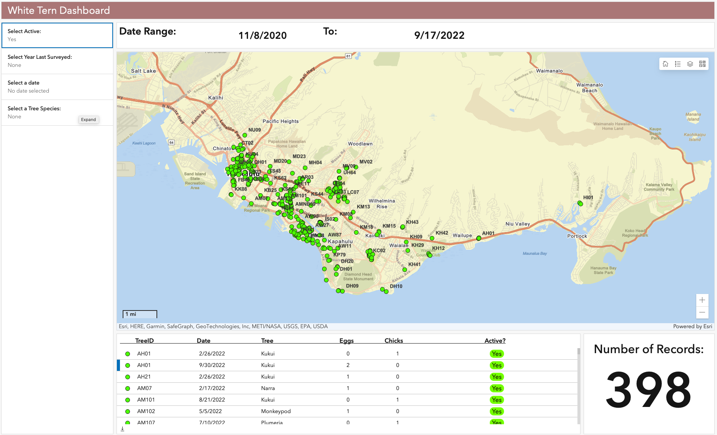
Integrating with ArcGIS Tools
Greater capability to interact with the data collected on White Tern breeding activity.

Slide 11
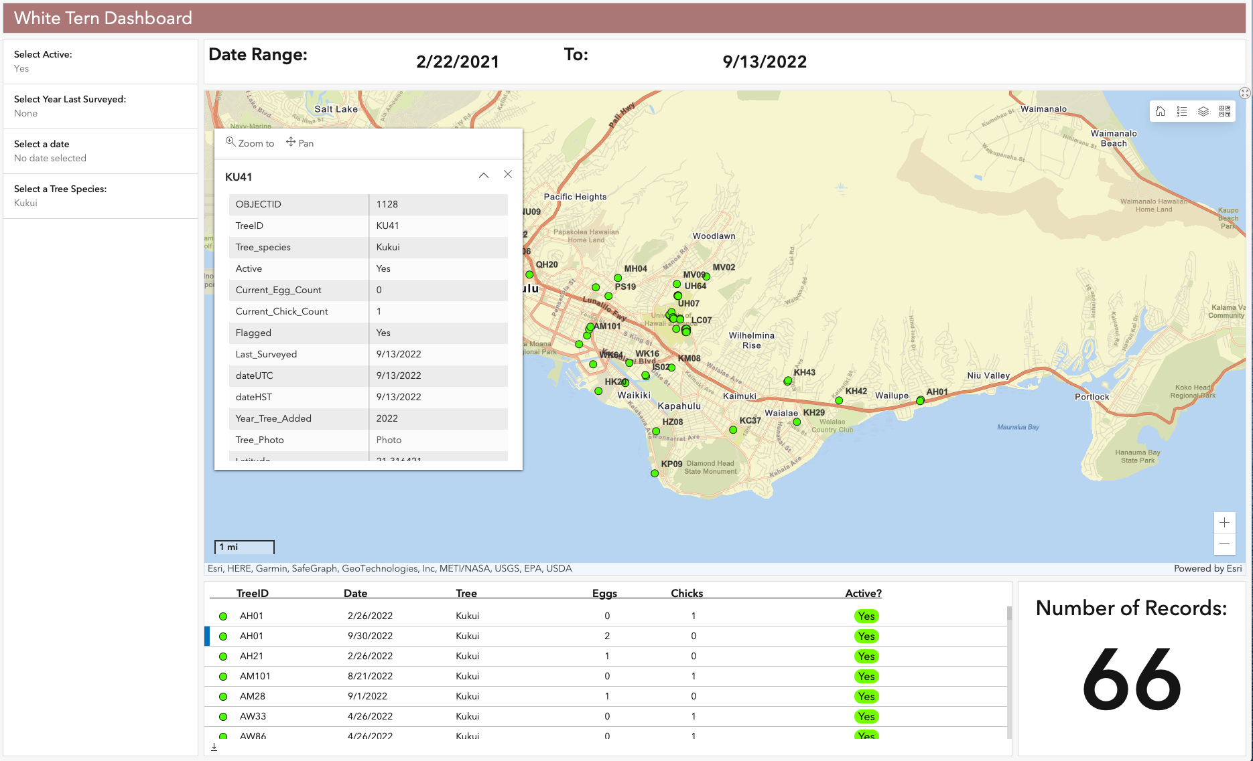
Integrating with ArcGIS Tools
Greater capability to interact with the data collected on White Tern breeding activity.

Slide 12
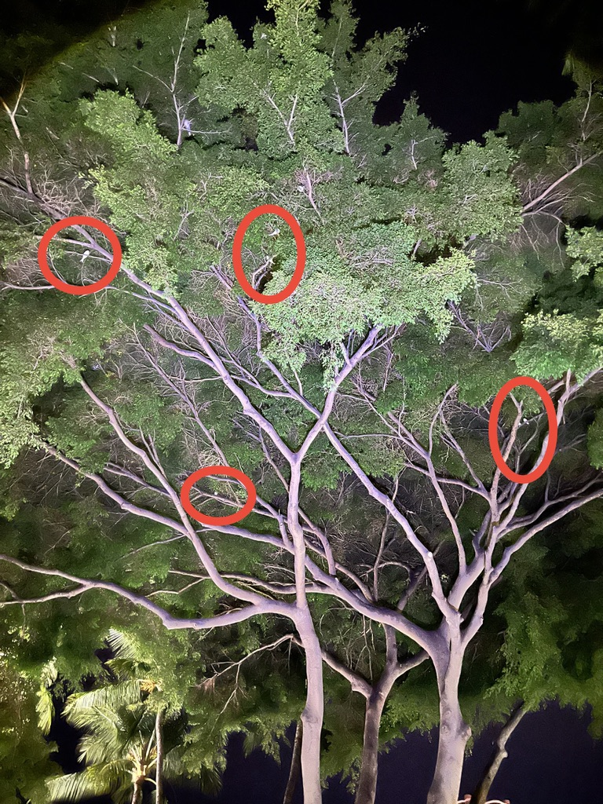
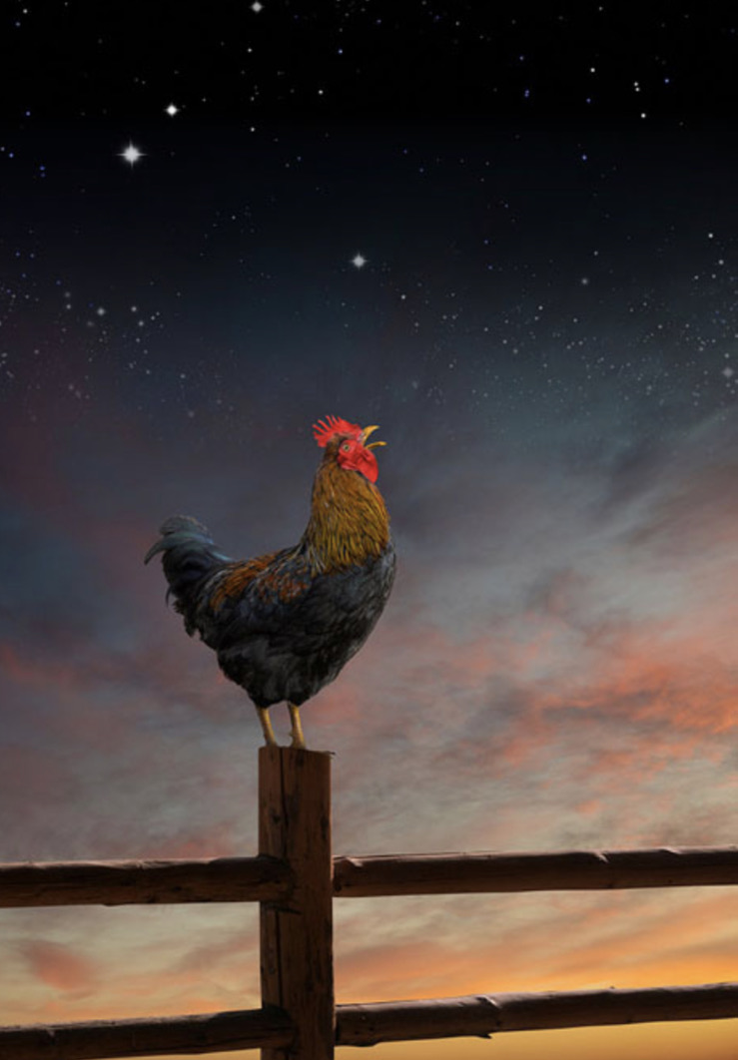
Night Roosters
This.
Not this.

Slide 13
Night Roosting
Breeding Trees / Night Roosting Trees

Slide 14
In 2019 the Aloha Arborist Association and Hui MOK partnered under a Kaulunani Grant to develop tern-sensitive tree care guidelines and BMP’s
Is it time to revisit training for trimmers on the tree guidelines and BMPʻs?

Slide 15
Aloha Arborist Association and Hui MOK partnered under a Kaulunani Grant to develop tern-sensitive tree care guidelines and BMP’s
PROJECT GOAL: Working with a comprehensive group of stakeholder representatives from both the tree care industry and the MOK stakeholder community, develop guidelines and BMPs for tree care near MOK nesting sites.
Provide training for the tree care industry for these guidelines and practices so that they will become established as common professional practice wherever white terns nest in trees.
Guidelines and BMPs are now widely available and accessible for tree care practitioners, the MOK community, and the lay community alike.
Training for tree care practitioners were carried out during the project’s Kaulunani grant period.
The guidelines and BMPs are fostering improved cooperation between the tree industry and MOK community, facilitating the ability of tree care practitioners to get their work done more efficiently and effectively, at the same time that tern populations are fostered and protected.

Slide 16
From Darienne Dey, Ph.D. Candidate, Department of Education, University of Hawai‘i at Manoa
The name “manu-o-Kū” can be translated into English as “bird of Kū” or “Kū’s bird.” Possible explanations for its name include a reference to the bird’s relationship with the Hawaiian deity Kū or descriptions of its behavior based on other meanings of kū. Instead of building nests, manu-o-Kū lay single eggs atop places along or at the intersection of branches, where natural pedestals (kū) form. At various times of day, manu-o-Kū leave their trees to forage at sea and usually return by sunset. After spending many days and nights relying on stars, swells, winds, and other natural clues to navigate canoes across vast expanses of ocean, Hawaiian and other Pacific wayfinders (in olden and modern times) rely on the presence of birds like manu-o-Kū at sea to reveal (kū) their canoe’s proximity to unseen land. Though wayfinders begin to look for these birds at first light (and until the darkness of night impedes visibility), they take special note of whether the manu-o-Kū is carrying fish in its beak: if its beak is empty, then it could be heading out away from land to fish, but if it has fish, then it is likely heading back towards land (and should be followed). Some fishermen also use manu-o-Kū to additionally reveal where running schools (kū) of predatory fish are located offshore, observing how the bird suddenly halts (kū) its flight, dives, and lightly strikes (kū) the surface of the water in order to collect small fish being driven upwards by larger fish.

Slide 17
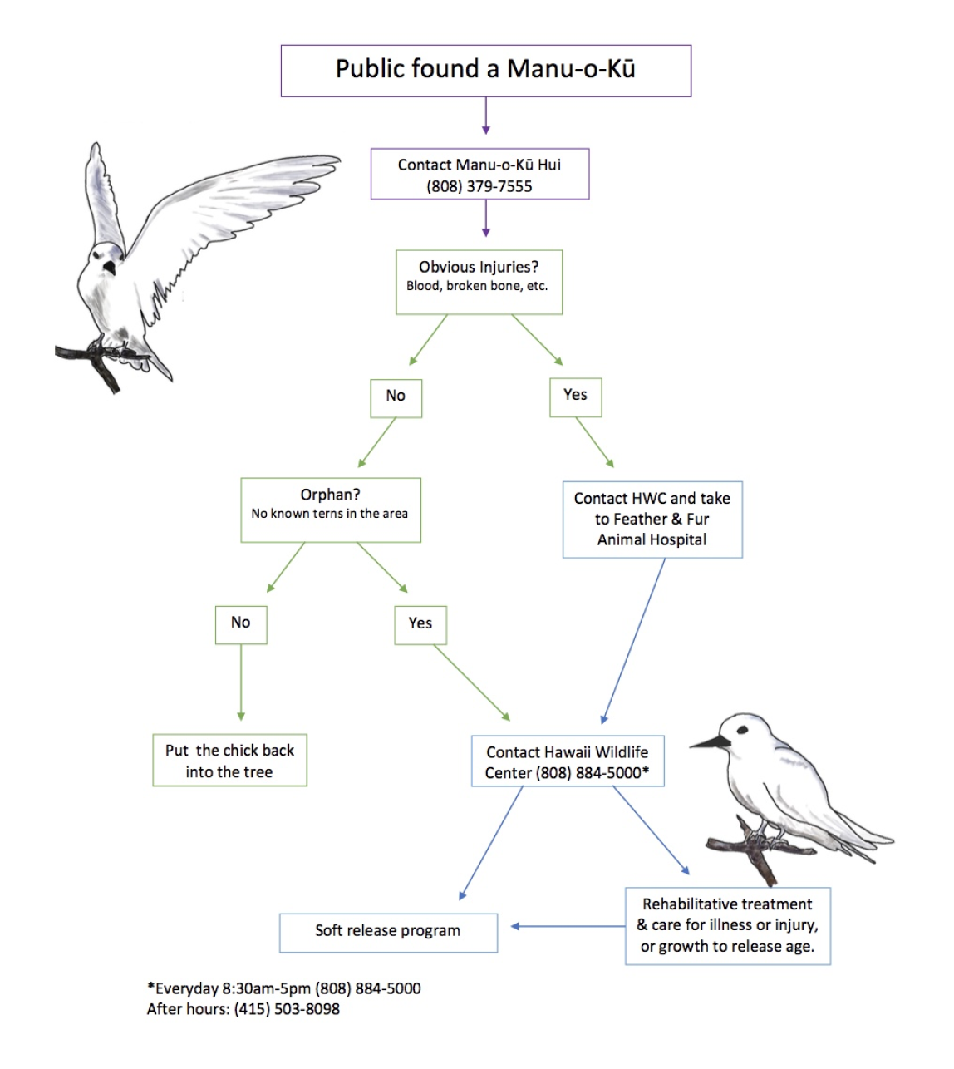
White Tern Rescue/Rehab/Release Partnership
Our Partners:
Hui MOK – Rescue, Reunite
HWC – Rehab
Honolulu Zoo - Release

Slide 18
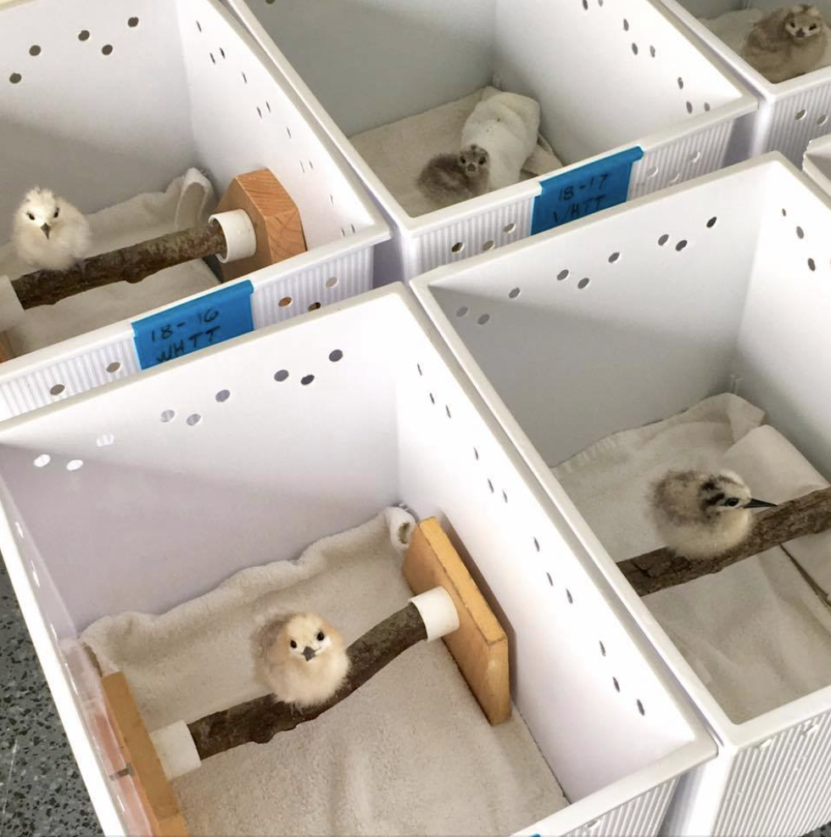
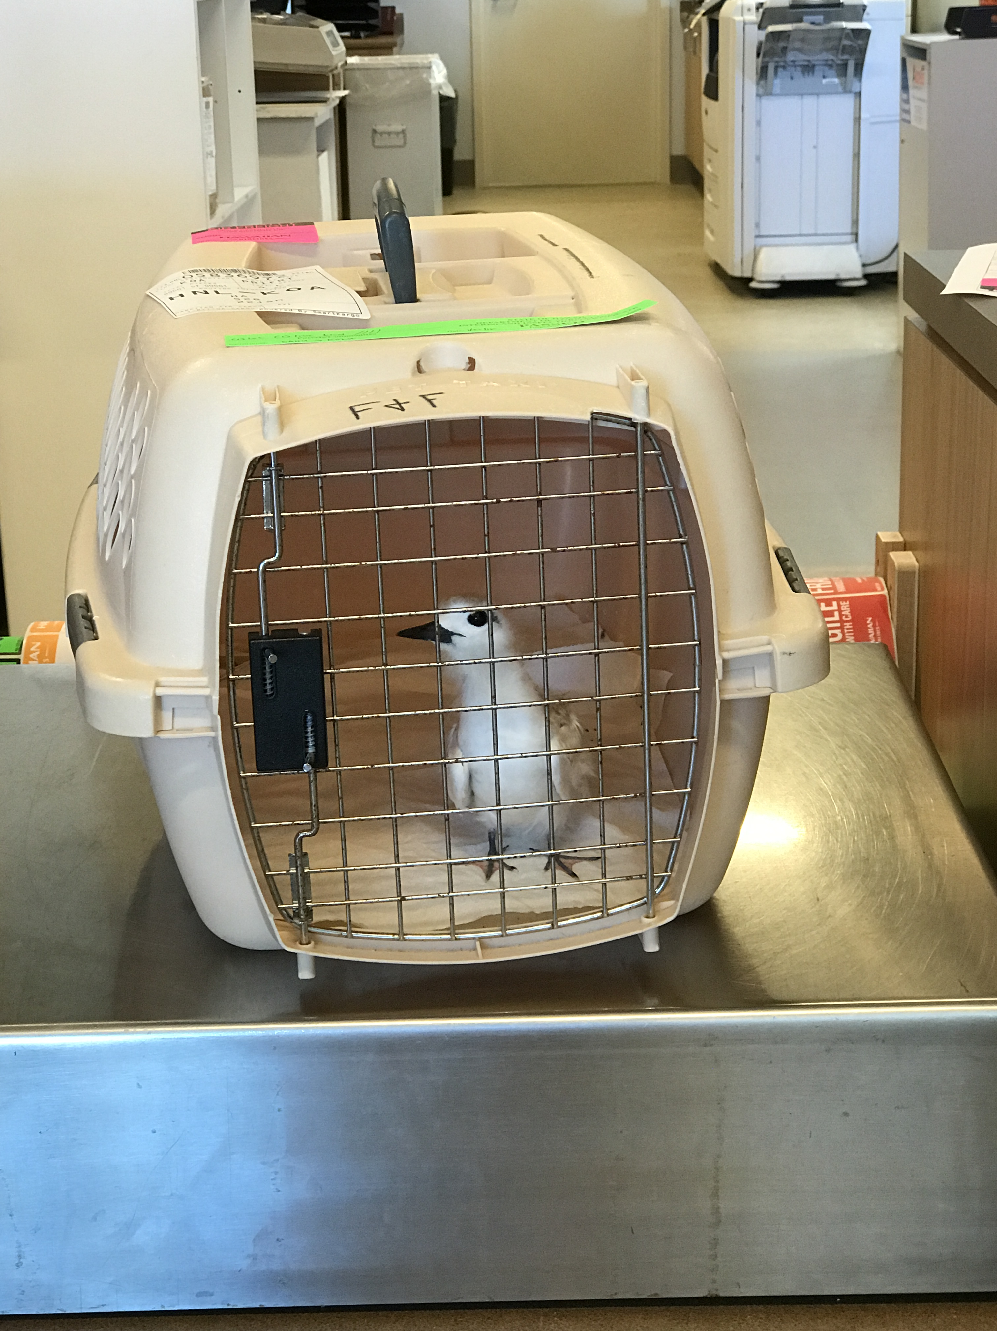
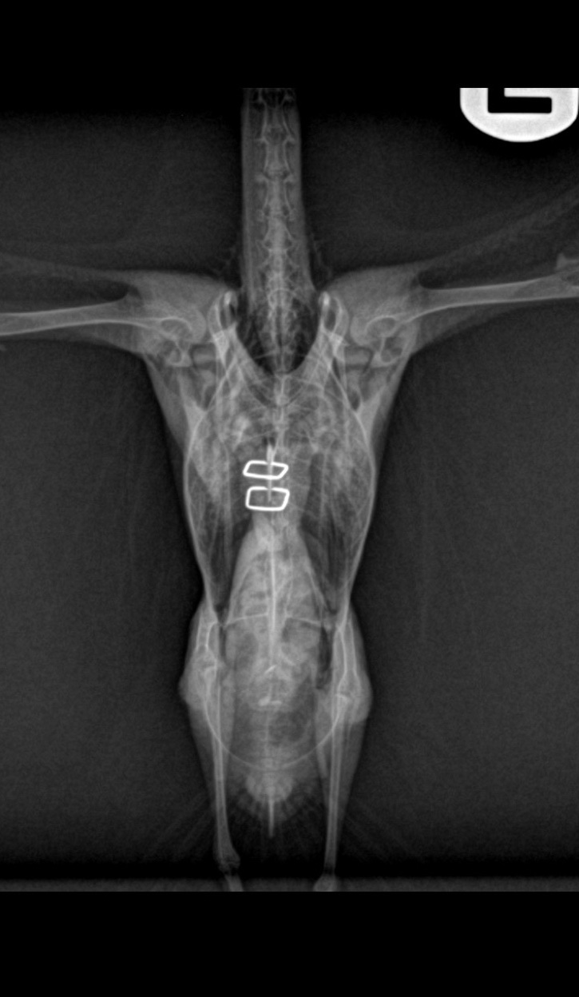
White Tern Rescue/Rehab/Release Partnership
Hawaii Wildlife Center
Partnering with Feather and Fur Animal Hospital on Oahu
“Wheels for Wildlife” volunteer drivers transport injured and orphaned birds to F&F and airport
White Terns are a significant portion of the patients treated by HWC annually.

Slide 19
Aviary/Flight Cage for Honolulu Zoo to Benefit White Terns in the Soft Release Program
Hawaii Wildlife Center
“This slow motion video captures the amazing flight and maneuvering skills of one Manu o Kū patient. It’s even more amazing considering that this bird was found with a broken wing and couldn’t fly at all nearly two months ago. The fracture was repaired by Feather and Fur Hospital and he’s been going through physical therapy here at HWC. It’s super awesome to see his progress! ”

Slide 20
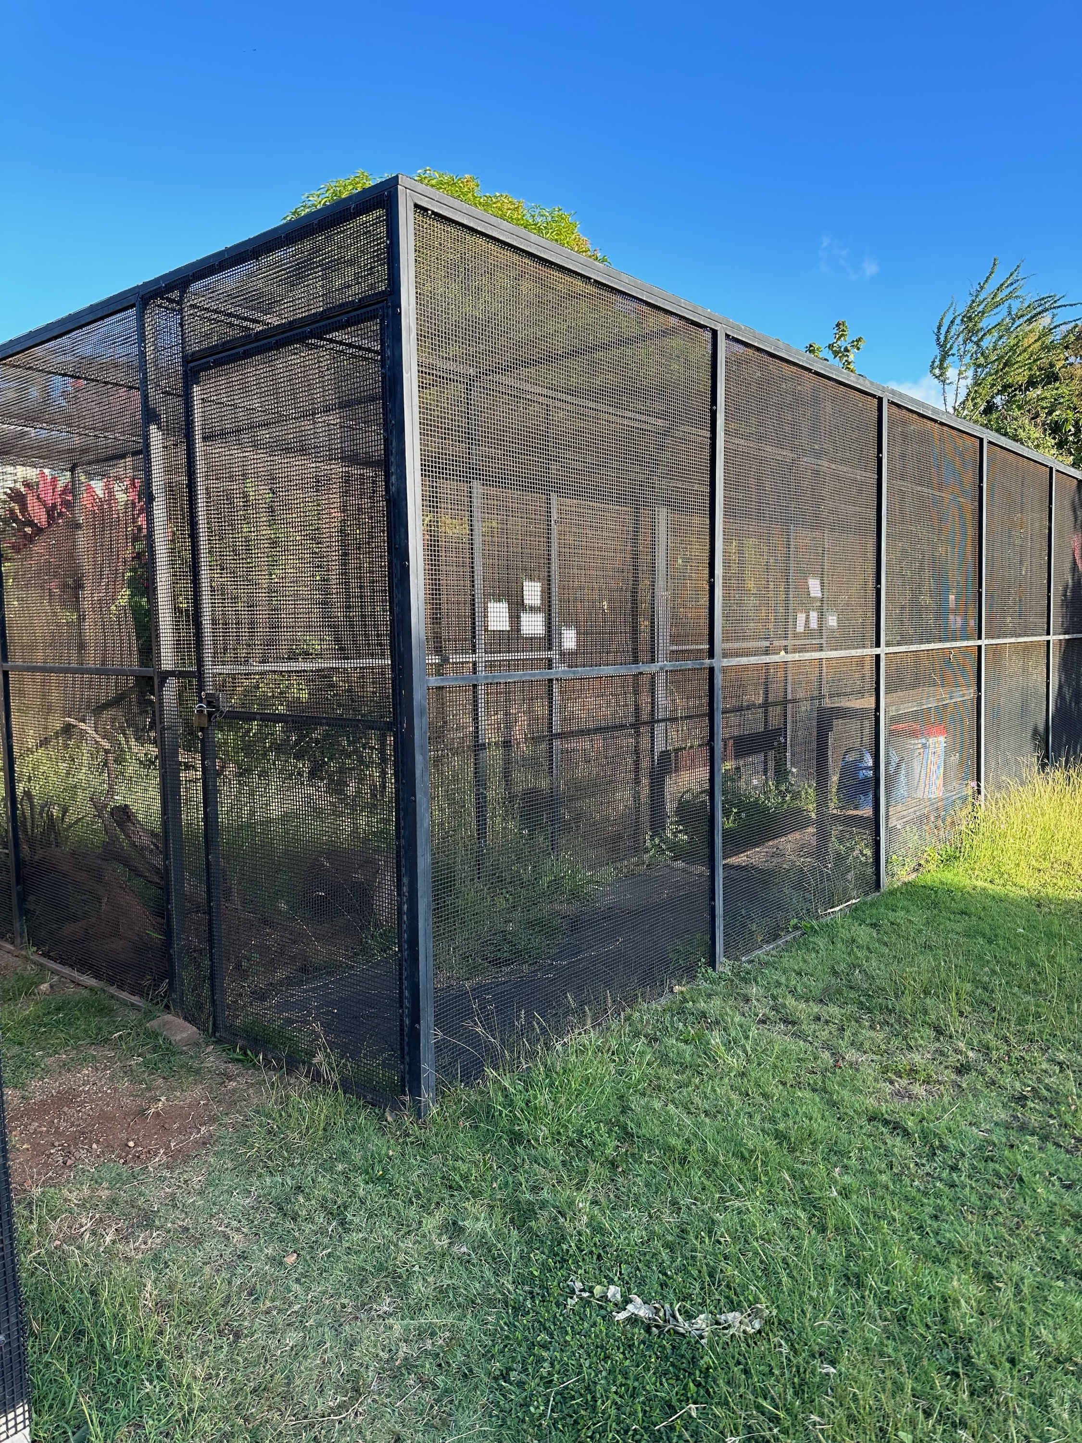
Aviary/Flight Cage for Honolulu Zoo to Benefit White Terns in the Soft Release Program
Hawaii Wildlife Center and Honolulu Zoo propose to erect a 12’ x 30’ x 10’ flight cage at the Zoo, similar to the one pictured here.

Slide 21
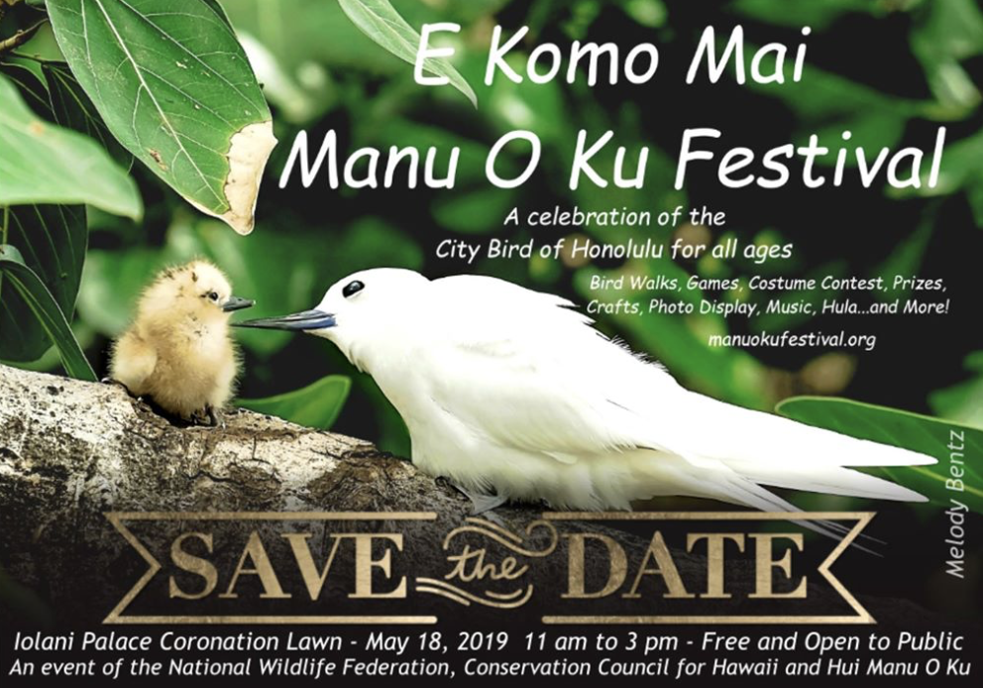
Manu o Kū Festival May 6, 2023

Slide 22
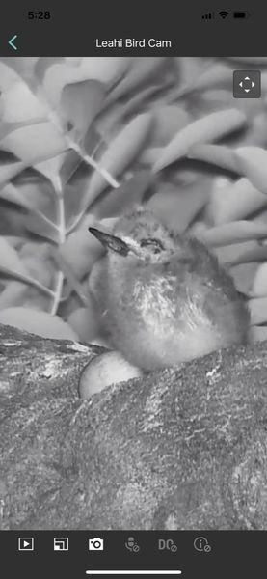
Notable White Tern Breeding Event
Involved
Single breeding pair simultaneously tending a chick and an egg
Longest documented delayed hatching of a White Tern egg (44 days)
Timeline
May 21 Egg 1 laid
June 26 Egg 1 hatched (35 days incubation)
July 22: Egg 2 laid
August 24: Egg 2 hatched (44 days incubation)
Chick 1 began branching soon after Egg 2 hatched.
September 15: Chick 2 died (malnourished)
October 12: Egg 3 laid on
November 16 hatched (35 days incubation)

Slide 23
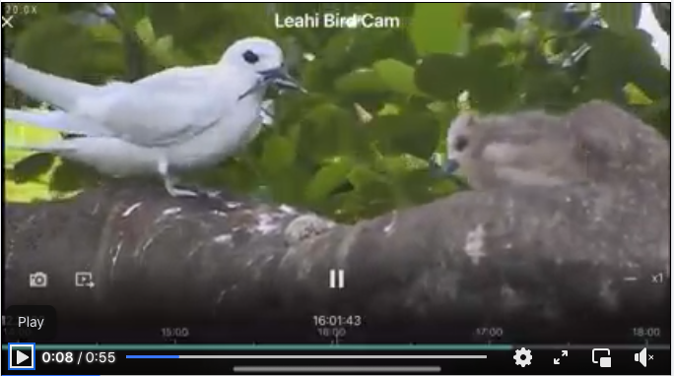
Notable White Tern Breeding Event
Feeding chick and tending egg simultaneously

Slide 24
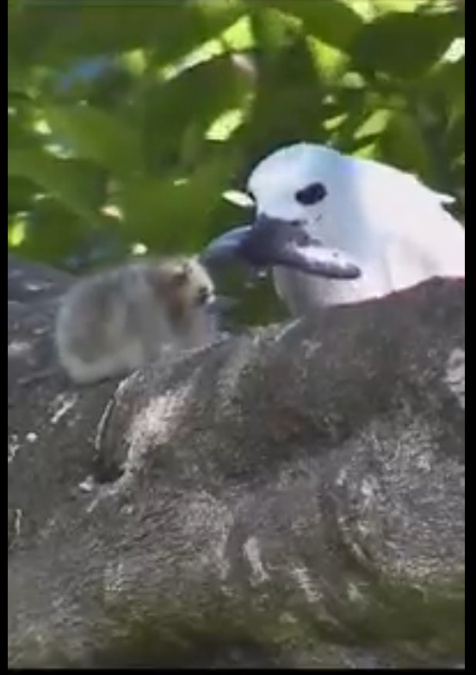
Notable White Tern Breeding Event
Tending 2 Chicks Simultaneously

